Slide 1
Optimization of the Apriori Algorithm Using Hadoop for Medical Data Analysis
Authors: Wenbin Zhuang, Lihong Fan Conference: 11th International Conference on Applications and Techniques in Cyber Intelligence

Slide 2
Introduction
The rapid growth of healthcare data has led to challenges in processing large datasets efficiently.
Medical data contains valuable insights but requires advanced data mining methods for extraction.
Traditional Apriori algorithm faces limitations such as excessive database scans and high computation time.
This research addresses these limitations using an improved Apriori algorithm on the Hadoop platform.

Slide 3
Problem Statement
Traditional Apriori algorithm struggles with processing large datasets due to its inherent limitations:
Frequent Database Scans: The database is scanned multiple times, causing performance issues.
Excessive Candidate Set Generation: A large number of item combinations are generated unnecessarily.
High Time Complexity: As data size grows, processing time increases exponentially.
These issues lead to bottlenecks, making the algorithm unsuitable for real-time medical applications.

Slide 4
Research Objectives
To design an efficient data mining algorithm suitable for large-scale medical datasets.
To minimize database scans by optimizing data processing using Hadoop’s distributed framework.
To reduce the number of candidate sets through better pruning and mapping strategies.
To ensure faster support calculation using parallel processing with Hadoop's MapReduce model.

Slide 5
Background
Hadoop and MapReduce: Distributed framework for managing and processing large-scale datasets.
Data Mining: Extracting useful patterns from large datasets using algorithms like Apriori.
Medical Data Processing: Requires high efficiency due to sensitive, high-volume, and time-critical nature.
Apriori Algorithm: A traditional method for association rule mining that needs optimization for big data applications.

Slide 6
Proposed Solution
The research proposes the Improved Apriori (IM Apriori) algorithm designed for Hadoop.
Key improvements include:
Reducing redundant candidate itemsets through optimized pruning.
Avoiding repeated scans by splitting data into smaller, manageable chunks.
Enhancing support calculation using parallel processing across Hadoop nodes.

Slide 7
IM Apriori - Step 1: Data Block Distribution
The transaction dataset is divided into smaller blocks based on user-defined sizes.
Each data block is distributed across DataNodes within the Hadoop cluster.
The division ensures even workload distribution, enabling efficient parallel processing.

Slide 8
IM Apriori - Step 2: Local Preprocessing & Pruning
Each Hadoop node processes its assigned data block independently.
Local pruning is performed using the minimum support threshold to filter infrequent items.
This pre-processing step reduces the size of candidate sets, minimizing further computations.

Slide 9
IM Apriori - Step 3: Combining Local Results
Local results from each node are merged using the Reduce function.
The merged candidate sets are compared against the global minimum support.
This step ensures that only globally frequent itemsets are retained for the next iteration.

Slide 10
IM Apriori - Step 4: Candidate Set Generation & Support Calculation
New candidate sets are generated by combining previous frequent itemsets using a self-connection process.
The Reduce function accumulates support counts from all nodes.
Items exceeding the minimum support threshold are selected as frequent itemsets for the next round.

Slide 11
IM Apriori - Step 5: Iteration and Rule Generation
The entire process of candidate generation, support accumulation, and pruning continues iteratively.
The process terminates when no new frequent itemsets are generated.
Strong association rules are extracted based on confidence levels from the frequent itemsets.

Slide 12
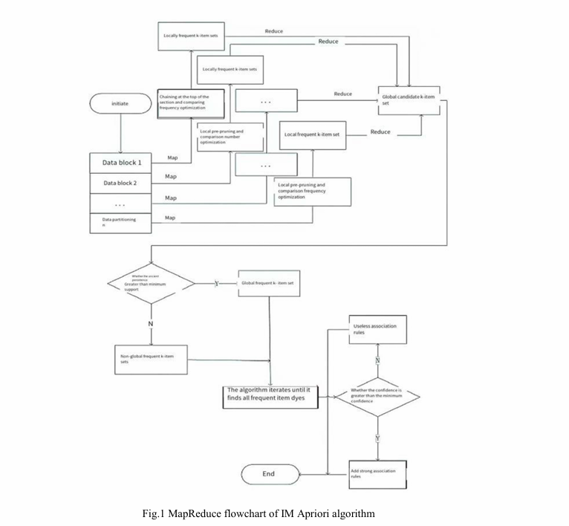

Slide 13
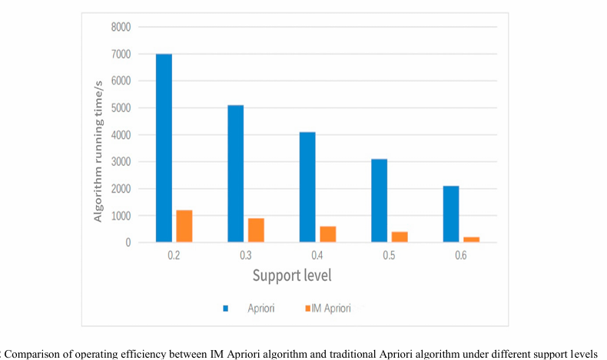
Performance Metrics
Time Complexity Reduction: The IM Apriori algorithm processes data in parallel, reducing computational time.

Slide 14
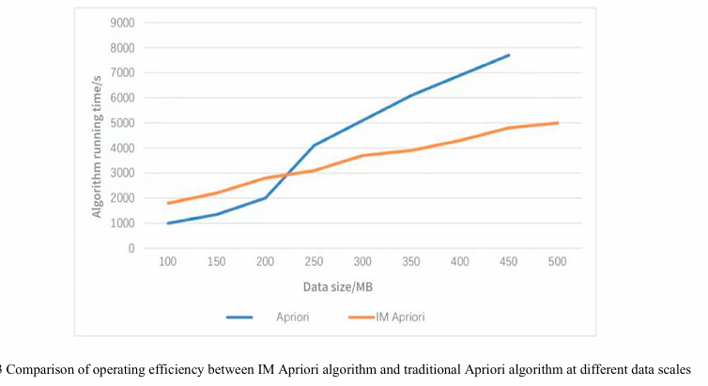
Performance Metrics
Database Scan Reduction: The algorithm minimizes the number of scans through smarter data distribution.

Slide 15
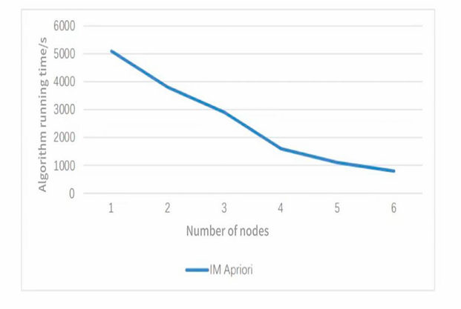
Performance Metrics
Improved Parallel Efficiency: Using Hadoop's MapReduce, data blocks are processed independently across nodes.

Slide 16
Experimental Setup
Dataset Parameters: Medical data with varying sizes, up to 230M records.
Support Thresholds: Minimum support values tested from 0.2 to 0.6.
Testing Environment: Simulations conducted on a Hadoop platform with varying cluster sizes.

Slide 17
Results - Support Comparison
The IM Apriori algorithm outperformed the traditional Apriori algorithm under all support threshold levels.
Higher support thresholds resulted in shorter processing times for both algorithms.
The performance gap widened as the support level increased, highlighting IM Apriori’s scalability.

Slide 18
Results - Node Count Comparison
Increasing the number of Hadoop nodes significantly reduced execution time.
A notable performance boost was observed with 3 to 4 nodes, indicating optimal scaling.
Beyond this range, diminishing returns occurred due to increased data communication overhead.

Slide 19
Applications
Medical Data Analysis: Mining medical records for disease prediction and patient care optimization.
Hospital Management: Improving resource utilization and reducing operational costs.
Healthcare Research: Supporting large-scale clinical trials and research studies through data-driven insights.

Slide 20
Conclusion & Future Work
The IM Apriori algorithm demonstrates significant efficiency improvements over the traditional Apriori algorithm.
It scales well for large datasets and minimizes computational overhead through Hadoop-based processing.
Future Work Suggestions:
Explore more advanced Hadoop optimizations.
Use larger datasets and real-world medical applications.
Extend the approach to other data mining tasks in healthcare.

Slide 21
Conclusion & Future Work
The IM Apriori algorithm demonstrates significant efficiency improvements over the traditional Apriori algorithm.
It scales well for large datasets and minimizes computational overhead through Hadoop-based processing.
Future Work Suggestions:
Explore more advanced Hadoop optimizations.
Use larger datasets and real-world medical applications.
Extend the approach to other data mining tasks in healthcare.

Slide 22
References
Research on the Optimization of Apriori Algorithm Based On Cloud Computing and Medical Information Data": https://www.sciencedirect.com/science/article/pii/S1877050924028229

